Slide 1


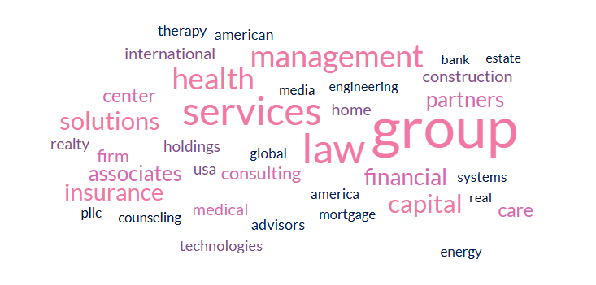



Datafest 2025: vitamin E
Mukto Akash, Jasmine Sun, Adrian Tang, Irene Chung

Slide 2
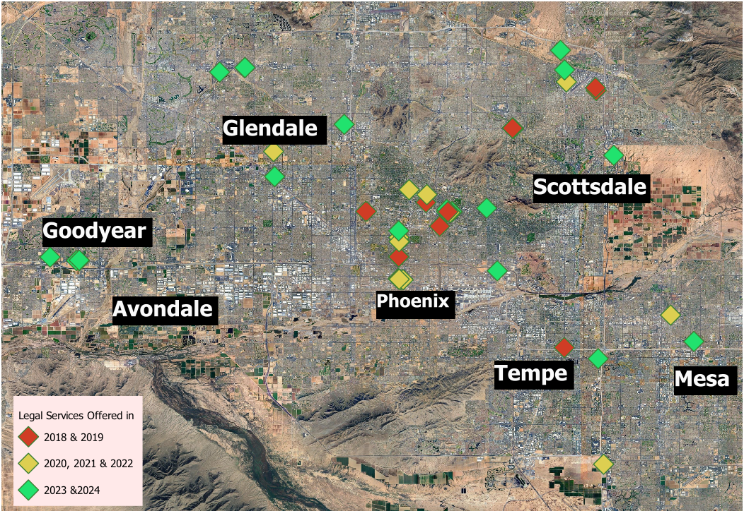


4.2%
Unemployment
25%
Vacancy
Average Rent
$27.92 - $31.13
per sqft
Sources: - Arizona Crime Statistics: Crime Overview 2024
- US Census Bureau: Population Estimates, July 1, 2024

Slide 3
